Slide 1

Chapter 5
Ranking with Indexes
SEG301m - Group 4 - AI1801
Mentor: Nguyễn Thị Hồng Nhung

Slide 2
Contents
5.1 Abstract model of raking
5.2 Inverted Indexes
5.3 Compression
5.4 Axuiliary structures
5.5 Index construction
5.6 Query processing

Slide 3
5.5 Index construction: simple construction
The process of simple index construction includes the following steps:
Iterate through all documents in the dataset.
Tokenize the document into a list of keywords (tokens).
Remove duplicate words within a document.
Store the document’s position in the index list.
Return a hash table containing the keyword list and corresponding documents.

Slide 4
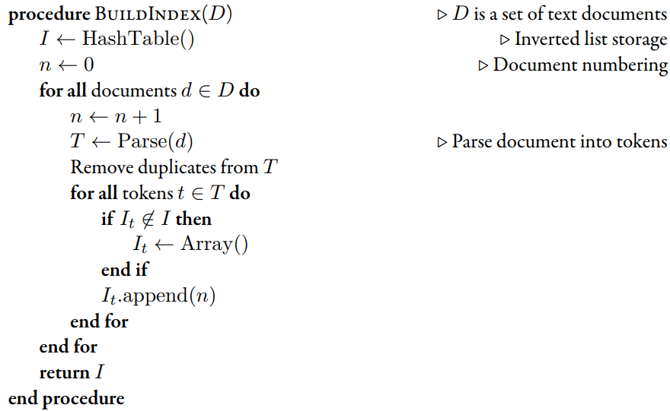
5.5 Index construction: simple construction
Pseudocode for a simple indexer

Slide 5
5.5 Index construction: merging
The merging process works as follows:
Iterate through two initial index lists (Index A and Index B).
If a keyword appears in both lists, merge their document lists and sort them.
If a keyword appears in only one list, keep it as is.
Return the merged index list.

Slide 6
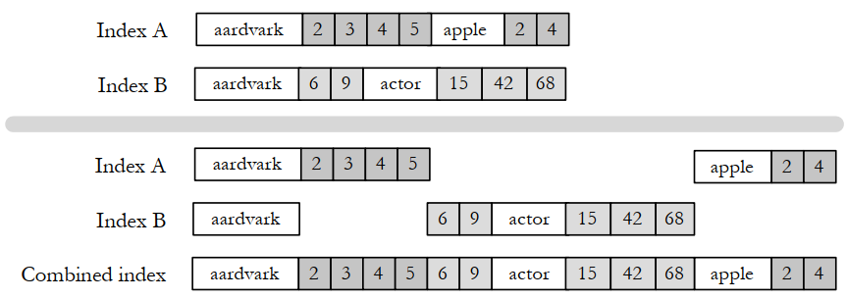
5.5 Index construction: merging
An example of index merging. The first and second indexes are merged together to produce the combined index

Slide 7
5.5 Index construction:parallelism and distribution
Use many inexpensive servers together and use distributed processing software to coordinate the activities of search engine
the amount of data to index in the largest systems is exploding
simple economics
RPC, CORBA, Java RMI, and SOAP have been developed to allow function calls across machine boundaries

Slide 8
5.5 Index construction: parallelism and distribution
Data placement: decides whether data processing is efficient
Example: Suppose you have a text file that contains data about credit card transactions. Each line of the file contains a credit card number and an amount of money. How might you determine the number of unique credit card numbers in the file?
Many files in one computer?
Many files in many computers?
Easiest way?

Slide 9
1. How to determine the number of unique credit card numbers in the file?
Use MapReduce or other data processing methods:
Using a Set in Python: Read each line, add the card number to a set, and get the set size.
Using SQL: If data is in a database, use SELECT COUNT(DISTINCT card_number) FROM transactions;.
Using MapReduce: The Mapper emits each card number with a value of 1, and the Reducer counts unique occurrences.

Slide 10
2. Processing multiple files on one computer?
Read each file sequentially and use a Set to store unique card numbers.
Use Pandas for large files (pd.read_csv() + nunique()).
If files are too large, use Apache Spark for distributed processing on a single machine.

Slide 11
3. Processing multiple files on multiple computers?
Using Hadoop MapReduce: Split data across machines, each Mapper detects unique card numbers, and the Reducer aggregates the results.
Using Apache Spark: Create an RDD from multiple files and use distinct().count() to count unique card numbers.
Using Distributed Databases such as Google BigQuery or Amazon Redshift

Slide 12
4. The easiest way?
If the file is small: Use Python (set() or pandas.nunique()).
If the file is large: Use SQL with DISTINCT or Apache Spark for faster processing.
If the data is extremely large: Use MapReduce on Hadoop or Google BigQuery.

Slide 13
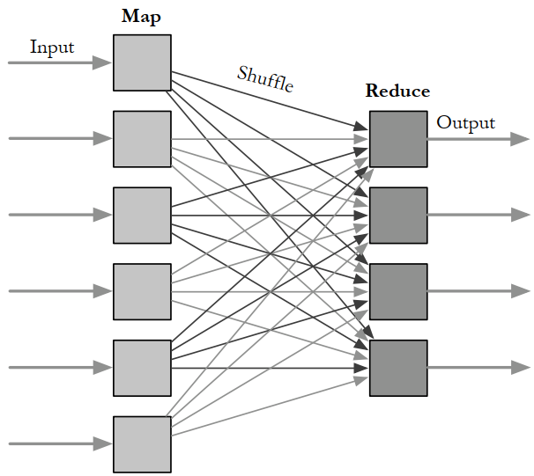
5.5 Index construction: parallelism and distribution
The MapReduce library automatically launches many Mapper and Reducer tasks on a cluster of machines

Slide 14
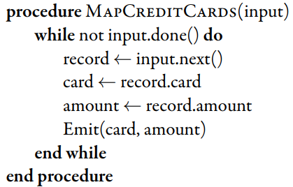
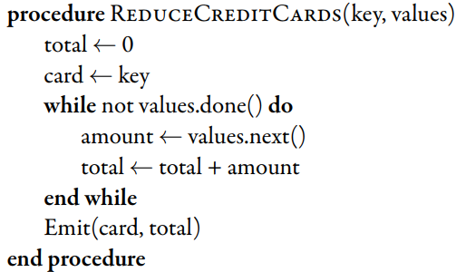
5.5 Index construction: parallelism and distribution
Mapper and Reducer tasks

Slide 15
5.5 Index construction: update
Most interesting document collections are constantly changing
Collections tend to get bigger over time
The contents of documents can change over time
Two techniques to solve the problem of update
Index merging
Result merging
Notes:
Index merging is a reasonable update strategy when index updates come in
large batches, perhaps many thousands of documents at a time.
Result merging solves the problem of how to handle new documents: just put
them in a new index.
35

Slide 16
THANK YOU

